Slide 1
Managing Update Conflicts in Bayou, a weekly connected Replicated Storage System
Terry, D. B., Theimer, M. M., Petersen, K., Demers, A. J., Spreitzer, M. J., & Hauser, C. H. (1995).
(Vol. 29, No. 5, pp. 172-182). ACM.
by Hugo Huipet

Slide 2
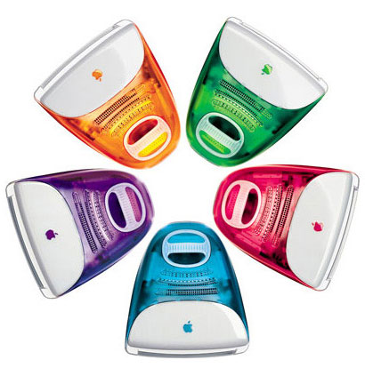
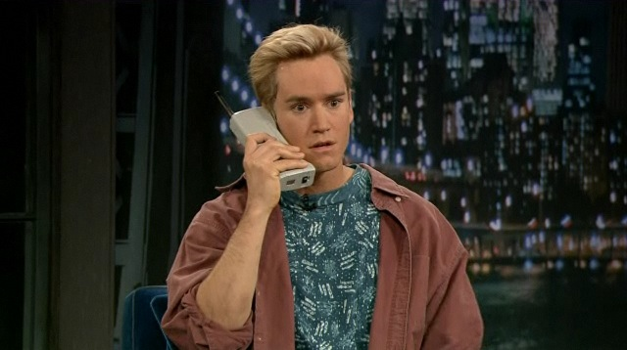
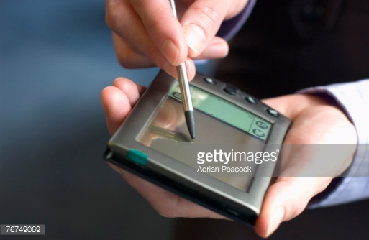
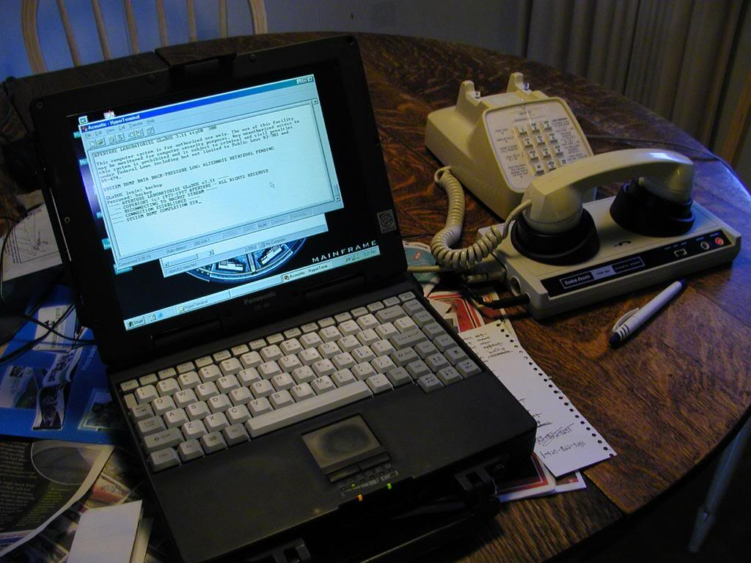
What is about?
The paper explains the concept of EVENTUALLY CONSISTENT through Bayou, a Storage System where the connection among servers is not taken for granted. Data is always accesible.
1995

Slide 3

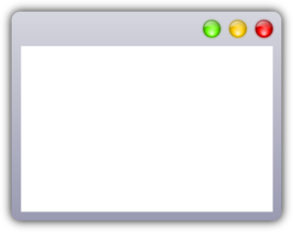

Basic Bayou System Model
Reads
Queries over a data collection
Writes
Can insert, modify or delete data items in a collection
Storage
System
Server State
Committed writes
Tentative writes
Application
Bayou API
Client Stub
R/W
Identifier (modif, time-stamp, server-ID)
*modif
ID

Slide 4
Bayou Mechanisms
Dependency Checks
Help the application specific conflict detection
Server specific information
Can detect Write-Write and Read-Write conflicts
Merge Procedures
Allows the application to specify the stems to resolve detected conflicts
Part of executing a WRITE in each server
If can’t resolve, log for manual resolution
Both are application specific

Slide 5

Application example: Meeting room scheduler
An applications that allows users to submit a request to reserve a meeting room. With alternatives if the time is already taken.

Slide 6
Conflicts
Reserve same room at same time: conflict
Reserve different rooms at same time: no conflict
Reserve same room at different times: no conflict
vs Bibliographic Database
Two bibliographic entries with different publications with the same Key: conflict
They are the same publication but has different Key: conflict
Only the application would know this!

Slide 7
Bayou System Model
Storage
System
Server State
Application
Bayou API
Client Stub
R/W
Anti entropy
Machine boundaries
R/W
Application
Bayou API
Client Stub

Slide 8
Eventually Consistent
All servers eventually receive all writes via pair-wise anti-entropy process and two servers with the same set of Writes will have the same data contents”.

Slide 9
Anti-entropy
Committed writes
Tentative writes
Writes are performed in the same order at all servers
Conflict Detection and Merge procedures are deterministic
Optimistic application of writes requires that writes be “undo-able”

Slide 10

Example 3 servers
*Example taken from: CS 268: Lecture 20 Classic Distributed Systems: Bayou and BFT
Ion Stoica
University of California, Berkeley
P
A
B
Anti entropy
Anti entropy
<inf,1,P>
<inf,2,A>
<inf,3,A>
<inf,4,P>
<inf,8,P>
<inf,10,A>
[8,10,0]
<inf,2,A>
<inf,3,A>
<inf,10,A>
[0,10,0]
<inf,1,B>
<inf,5,B>
<inf,9,B>
[0,0,9]
<1,1,P>
<2,2,A>
<3,3,A>
<4,1,B>
<5,4,P>
<6,5,B>
<7,8,P>
<inf,9,B>
<inf,10,A>
[8,10,9]
<1,1,P>
<2,2,A>
<3,3,A>
<inf,1,B>
<inf,4,P>
<inf,5,B>
<inf,8,P>
<inf,9,B>
<inf,10,A>
[8,10,9]
<1,1,P>
<2,2,A>
<3,3,A>
<inf,4,P>
<inf,8,P>
<inf,10,A>
[8,10,0]
<inf,1,P>
<inf,4,P>
<inf,8,P>
[8,0,0]
<inf,1,P>
<inf,2,A>
<inf,3,A>
<inf,4,P>
<inf,8,P>
<inf,10,A>
[8,10,0]
<1,1,P>
<2,2,A>
<3,3,A>
<inf,1,B>
<inf,4,P>
<inf,5,B>
<inf,8,P>
<inf,9,B>
<inf,10,A>
[8,10,9]
TENTATIVE WRITES
TENTATIVE WRITES
Commits early writes
More Commits!
END

Slide 11
Thanks!

Slide 12
Quotations are commonly printed as a means of inspiration and to invoke philosophical thoughts from the reader.

Slide 13
BIG concept
Bring the attention of your audience over a key concept using icons or illustrations

Slide 14
In two or three columns
Yellow
Is the color of gold, butter and ripe lemons. In the spectrum of visible light, yellow is found between green and orange.
Blue
Is the colour of the clear sky and the deep sea. It is located between violet and green on the optical spectrum.
Red
Is the color of blood, and because of this it has historically been associated with sacrifice, danger and courage.

Slide 15
Let’s review some concepts
Yellow
Is the color of gold, butter and ripe lemons. In the spectrum of visible light, yellow is found between green and orange.
Blue
Is the colour of the clear sky and the deep sea. It is located between violet and green on the optical spectrum.
Red
Is the color of blood, and because of this it has historically been associated with sacrifice, danger and courage.
Yellow
Is the color of gold, butter and ripe lemons. In the spectrum of visible light, yellow is found between green and orange.
Blue
Is the colour of the clear sky and the deep sea. It is located between violet and green on the optical spectrum.
Red
Is the color of blood, and because of this it has historically been associated with sacrifice, danger and courage.

